Slide 1
SITE ANALYSIS
ALLAN’S WATER, FRASERS HILL
EXISTING STRUCTURES & MATERIALITY
Group Members
Adrian Seow Chen Wah
Tang Kar Jun
Pua Zhi Qin
El Munzir Osama Hassan
By: Adrian Seow, Pua Zhi Qin, Tang Kar Jun, El Munzir Osama Hassan

Slide 2
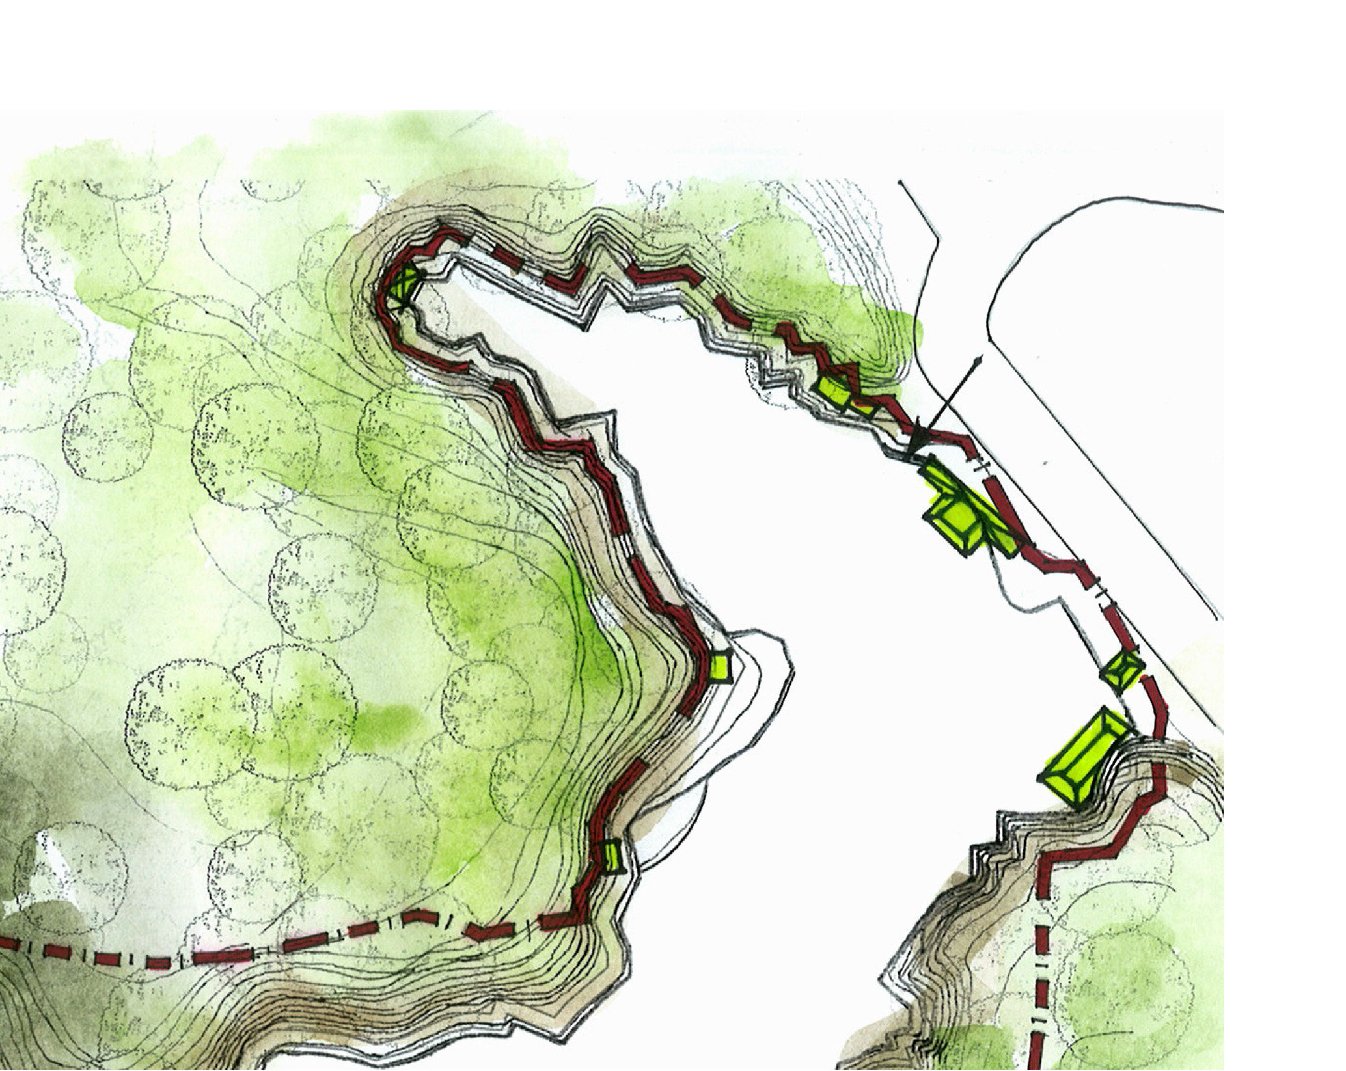
Location for the pathway lighting
- Pathway Lighting point
By: Adrian Seow, Pua Zhi Qin, Tang Kar Jun, El Munzir Osama Hassan

Slide 3
Location for the bird feeding
TITLE
-Bird Feeding Tower
By: Adrian Seow, Pua Zhi Qin, Tang Kar Jun, El Munzir Osama Hassan

Slide 4
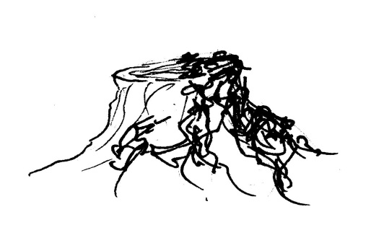
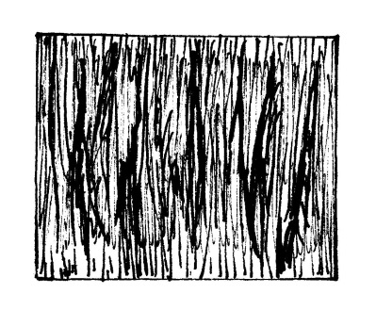
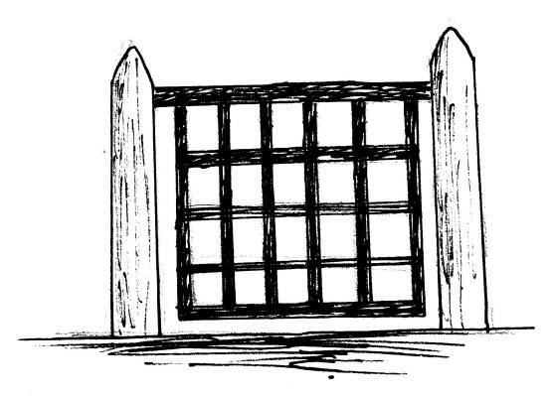
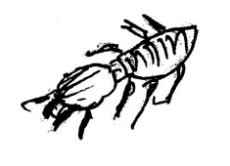
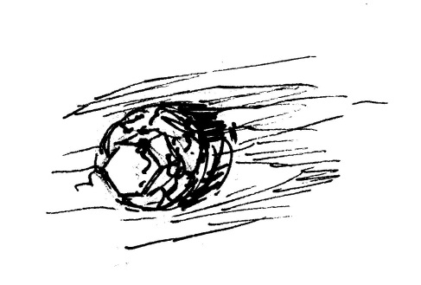
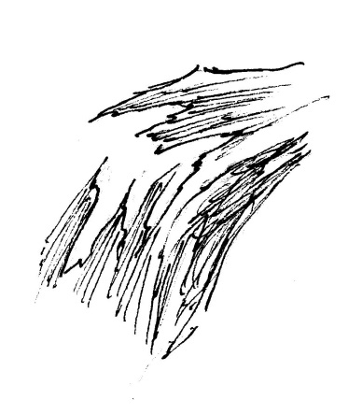
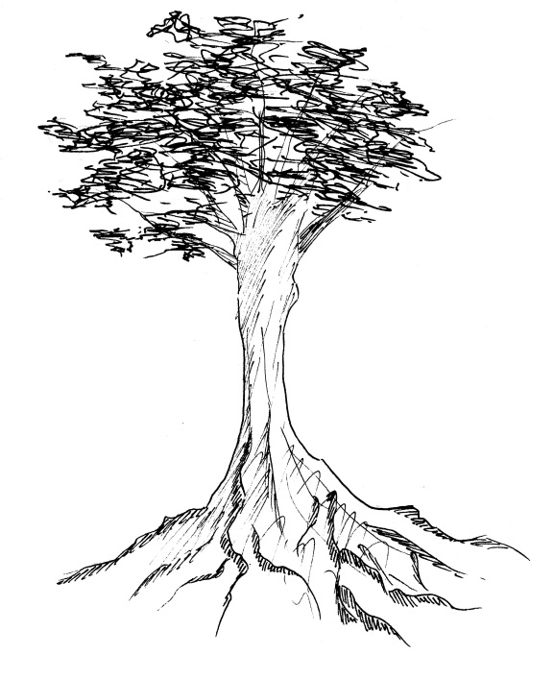
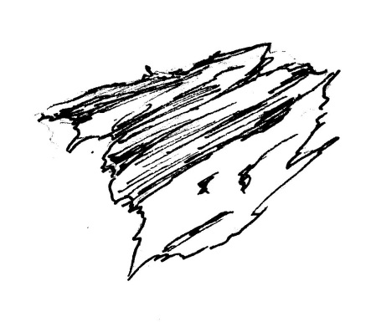
Materials Analysis
Weakness:
~cannot withstand high moisture (causing moss to grow)
~susceptible to termite attacks
1. Bridge Railing
Kempas wood texture
Strength:
~durable
~inexpensive
~easy to install
Timeline Course:
~Kempas is slightly acidic and corrodes metals. This causes the bolts to rust.
~brittle areas have blunting effects on cutting edges.
Material suitability:
Not suitable as rust occurs after a long period of time.
Material usability: Kempas wood is better suited for flooring but not as a bridge in a jungle.
Made out of kempas wood
By: Adrian Seow, Pua Zhi Qin, Tang Kar Jun, El Munzir Osama Hassan

Slide 5
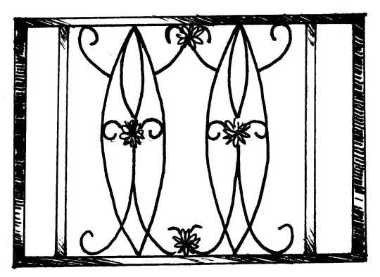
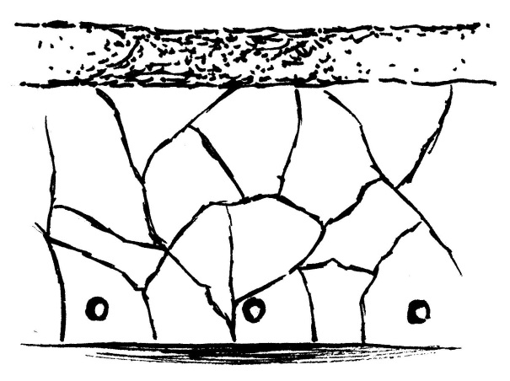
2. Steel with bronze coating
3. Concrete Walls with Drainage holes
Material suitability: It is suitable as metal’s strength can withstand pressure when leaned on against. This prevents people from falling over into the water.
Material usability: Versatile when it comes to modification and repair, therefore can be preserved at site for a long time frame.
Material suitability: its very suitable for blocking water waves from splashing in.
Strength:
~Malleable and ductile
~High aesthetic value
~Good wear resistance
Strength:
~Steady and firm structure
~The drainage pipe is there to remove excess water during high tide to low tide
Weakness:
~Costly waste
~Environmental issue (high embodied energy)
Timeline Course: After certain period of time the stain makes it not aesthetically pleasing, especially the drainage holes.
Weakness:
~Easily stained from dirt (soil)
Timeline Course: Coating will fade in time and the metal underneath will be prone to rust
By: Adrian Seow, Pua Zhi Qin, Tang Kar Jun, El Munzir Osama Hassan

Slide 6
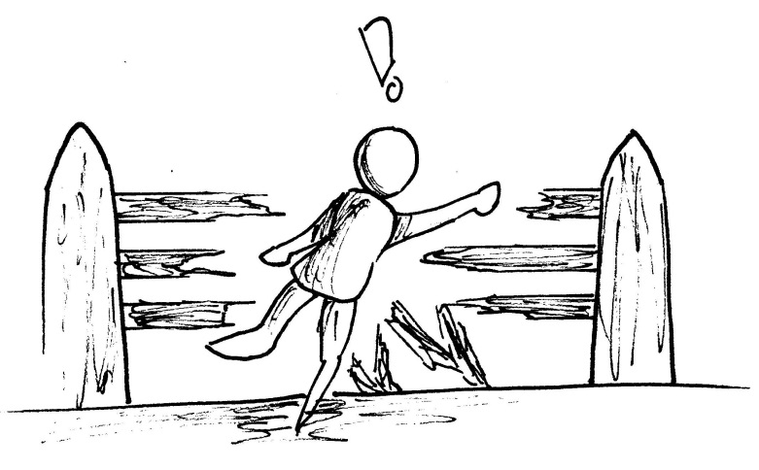
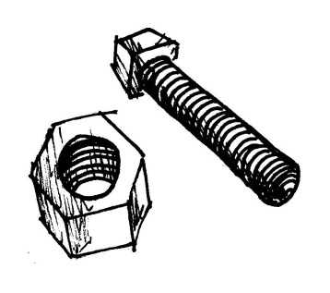
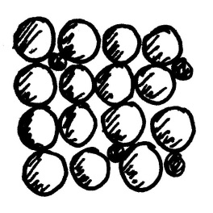
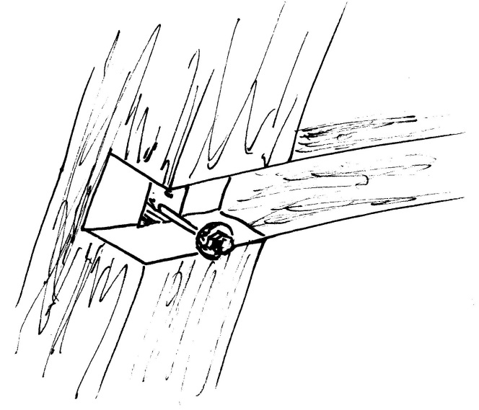
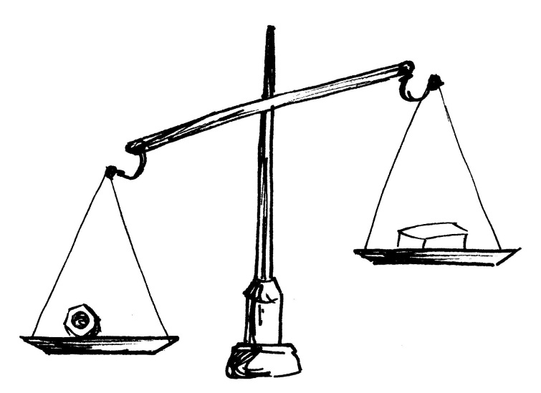
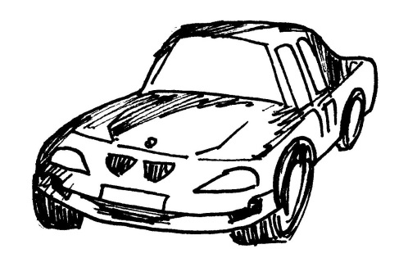
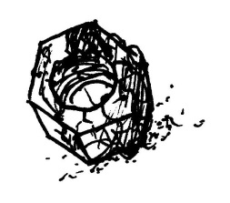
4. Bridge Nuts & Bolts
Timeline Course: The nuts and bolts will rust and since it is a connector, it will cause the wooden railing to collapse and is dangerous.
Made of medium carbon steel
Strength:
~An alloy of iron and carbon (strength)
~balanced ductility
~good wear resistance
Diagram depicting the joint of the nuts and blots with the wood railing earlier
Weakness:
~rusts rather quickly
Medium carbon steel
Material suitability: Not suitable as rust occurs after a long period of time.
Material usability: Better suited for forging car parts.
Stainless steel
By: Adrian Seow, Pua Zhi Qin, Tang Kar Jun, El Munzir Osama Hassan

Slide 7
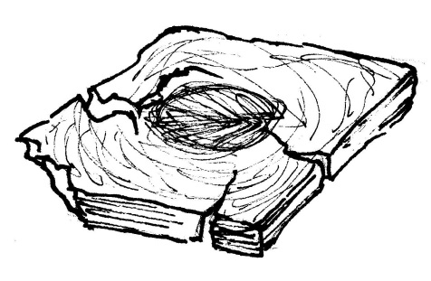

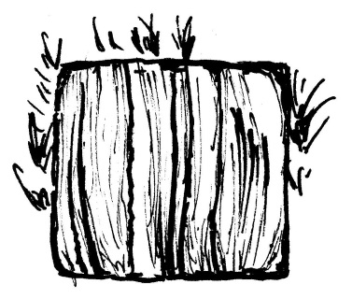
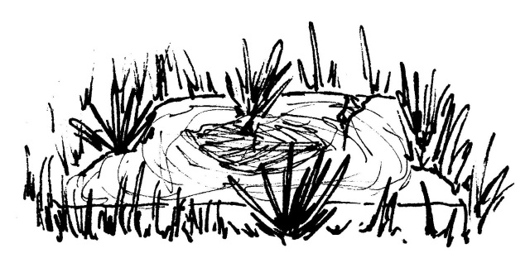
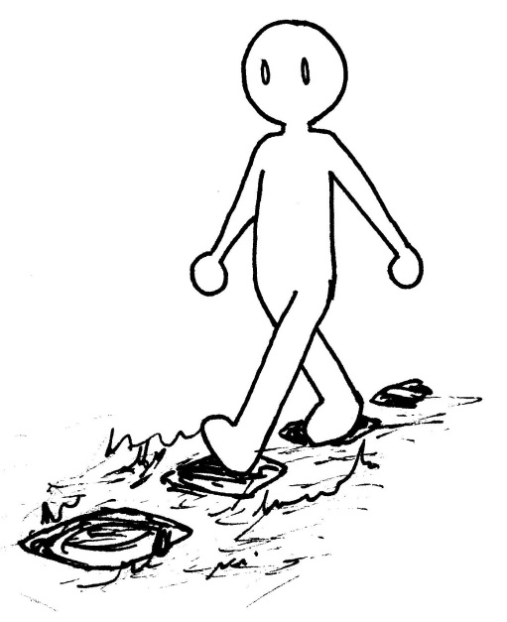
5. Concrete tiles tiles
Weakness : if not properly sealed on both top and bottom, it will be susceptible to penetration by moisture. This causes the floor tile to crack
Made of concrete tiles
Timeline Course : because the tiles are surrounded by grass and is exposed to rain, it will crack over a period of time. The grass will also grow through the cracks.
Strength : Provides a flat surface to step on and is extremely tough and resilient being able to withstand pressure
Suitability of Material : as a step it’s a good choice of material but the location for it is not suitable
Usability of Material : the concrete tiles are better suited for building construction and though it has good aesthetic value, the tile will not last very long.
By: Adrian Seow, Pua Zhi Qin, Tang Kar Jun, El Munzir Osama Hassan

Slide 8
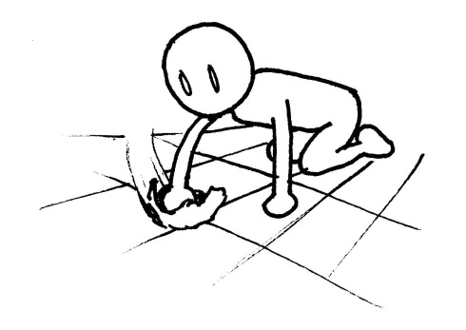
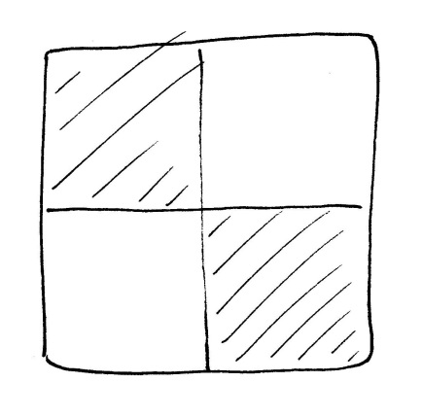
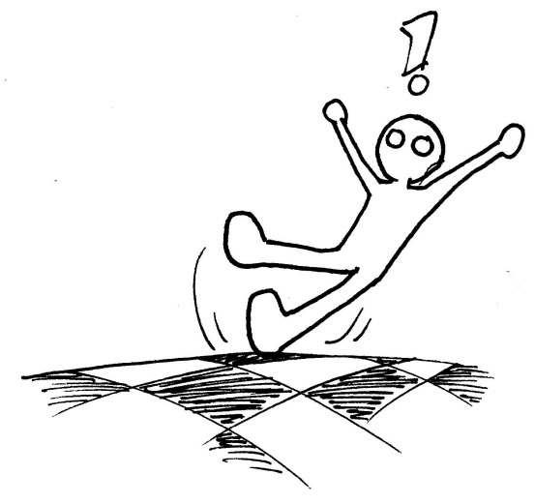


6. Ceramic tiles
Strength : Very durable and also easy to clean as it doesn’t harbor germs. It is easily installed and has low-cost value
Weakness : the tiles are vulnerable to breakage and also can be very slippery when surface is wet
Timeline Course : Ceramic tiles have a long-lasting span of usage which lasts for 10-20 years and if broken, can be easily replaced. As the ceramic is placed at the building and is not close to the river, it can be maintained properly.
Suitability of Material : A good selection of tile for the buildings over there as it is pretty much away from any harm
Usability of Material : the ceramic tiles are suited best for flooring material and has been used efficiently at the site
By: Adrian Seow, Pua Zhi Qin, Tang Kar Jun, El Munzir Osama Hassan

Slide 9
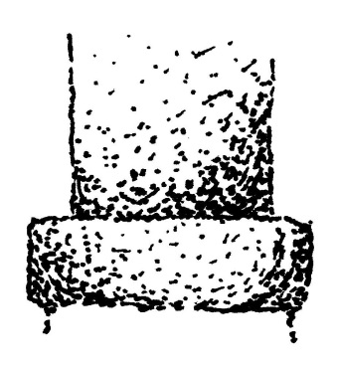
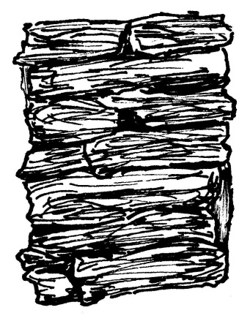

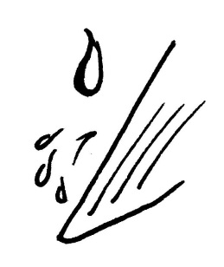



7. Concrete and stone pillars
7. Concrete and stone pillars
Weakness (Concrete) : the area it is built upon must have the plantation around it removed before it can be built. However, after construction, plants can be planted again.
Weakness (Stone) : the design has stone edges pointing out and can prove to be dangerous.
Strength :
Eco-friendly and a practical option. Extremely reliable for their strength and is commonly used. Capable of withstanding oncoming wind and water-resistance
Strength :
Eco-friendly and a practical option. Extremely reliable for their strength and is commonly used. Capable of withstanding oncoming wind and water-resistance
Timeline Course : Both pillars are extremely tough and durable making it able to stand firm for a very long time.
Suitability of Material : A good choice of material for a hut for recreational purposes as it has good strength
Usability of Material : Common choice of pillars and is also used worldwide due to its low cost and aesthetic values
By: Adrian Seow, Pua Zhi Qin, Tang Kar Jun, El Munzir Osama Hassan

Slide 10

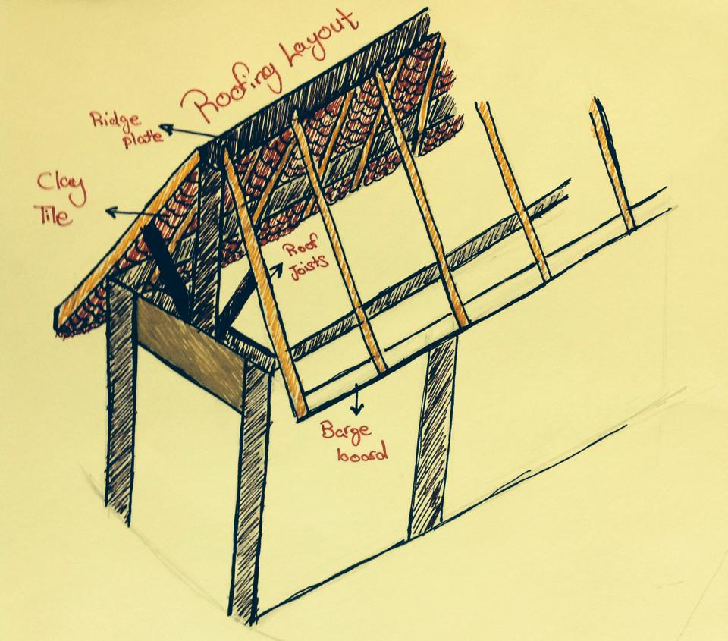
8. Roofing
Suitability of material: Clay roof tiles are fire-proof, as well as being impervious to the kinds of rot, mold, and water damage that can destroy other roofing materials.
Material: Clay Tile
Strength: Long lasting and a very good heat insulator making the inside cooling
Usability of material: It has a single roll rather than being totally flat. It can be installed on low pitches with gauge variability, whilst offering the attractiveness of “fine cornet” tile guaranteed weather-tightness
Timeline : Looking at the weather condition on our site, Clay tile could be the best option as roofing material simply because it’s durable and long-lasting which make it able to resist decay for a long period of time.
By: Adrian Seow, Pua Zhi Qin, Tang Kar Jun, El Munzir Osama Hassan

Slide 11
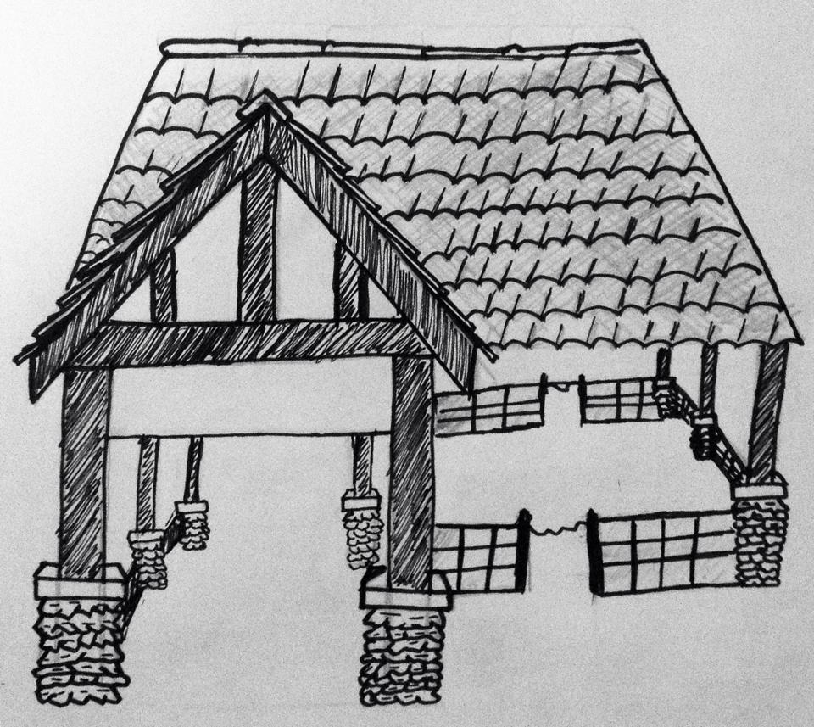
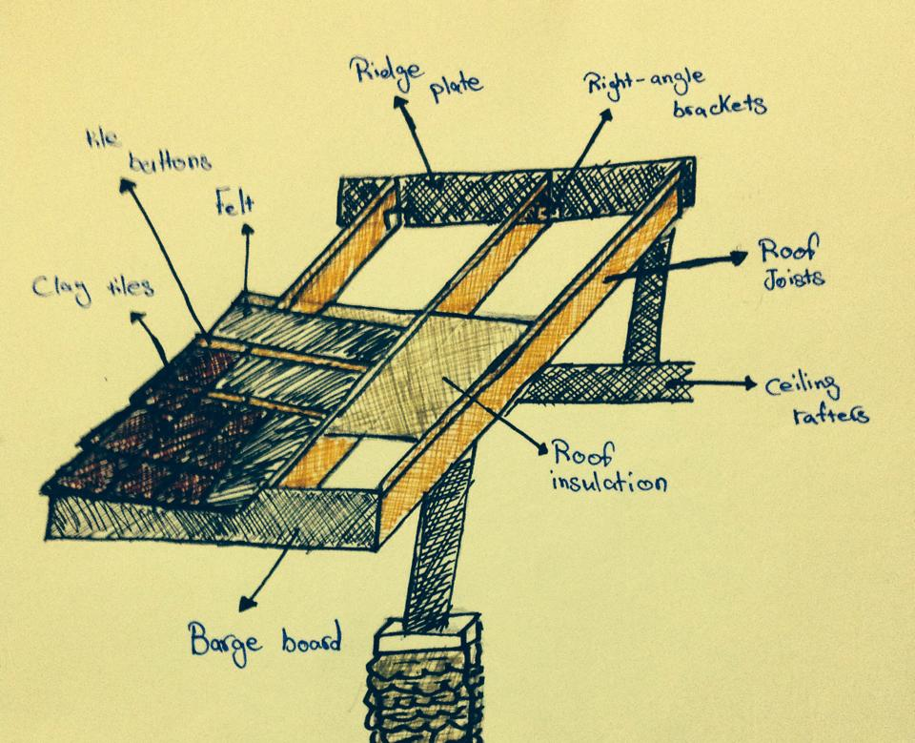
9. Roof structure
Strength: They used heavy timbers. This gives the massive solid appearance.
Weakness: On the downside, timber is subject to rot or warp, especially if exposed to the elements.
Timeline Course: Over time this wood will attracts insect invaders, such as termites, and is more likely to suffer damage during violent weather or high winds.
Suitability of material: It’s not very suitable as its highly dependent on the weather condition.
By: Adrian Seow, Pua Zhi Qin, Tang Kar Jun, El Munzir Osama Hassan

Slide 12
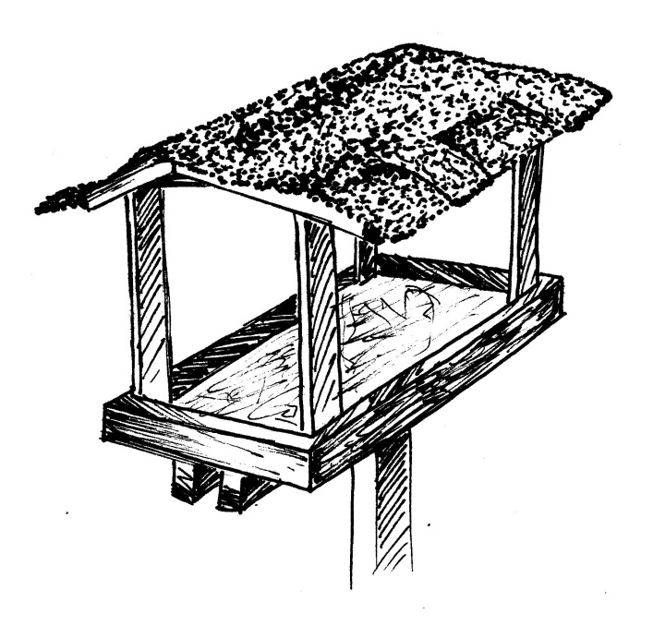
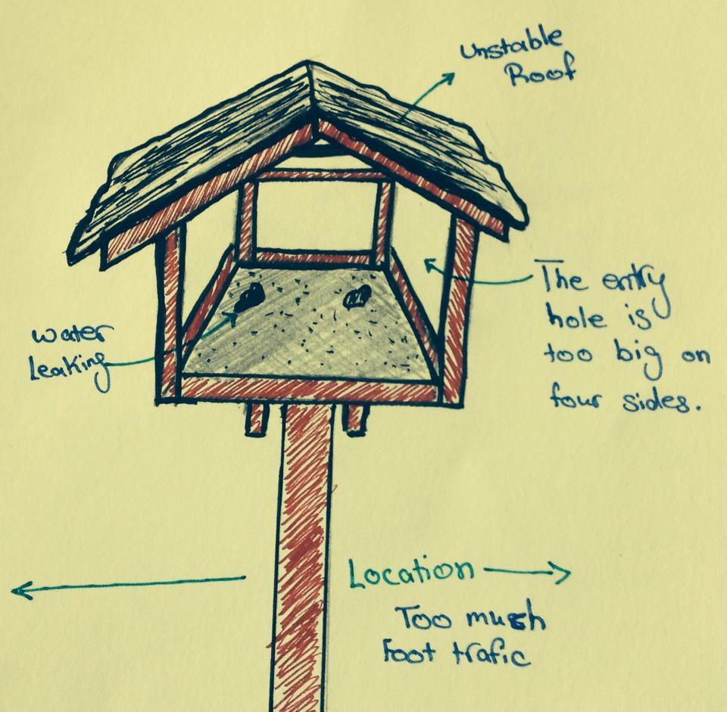
10. Bird feeding centre
Fraser's Hill is a paradise for bird watching and photography with over 270 species of local and migratory birds flocking together here. And at our site here is a centre for bird feeding and to be admired at.
Matte with stone finishing
Strength: built for the sake of the birds?
Timeline Course: it depends on the location of the birdhouse.
Usability of material: Often, birds won't use a new house until it shows some age. Weathering also softens up the wood, making it dangerous for young ones to grab hold. A painted, decorated birdhouse may be cute, but unvarnished cedar, pine or redwood will get more use.
Suitability of material: The material used for the roof is matte with stone finishing to make the bird feeding area look natural.
By: Adrian Seow, Pua Zhi Qin, Tang Kar Jun, El Munzir Osama Hassan

Slide 13
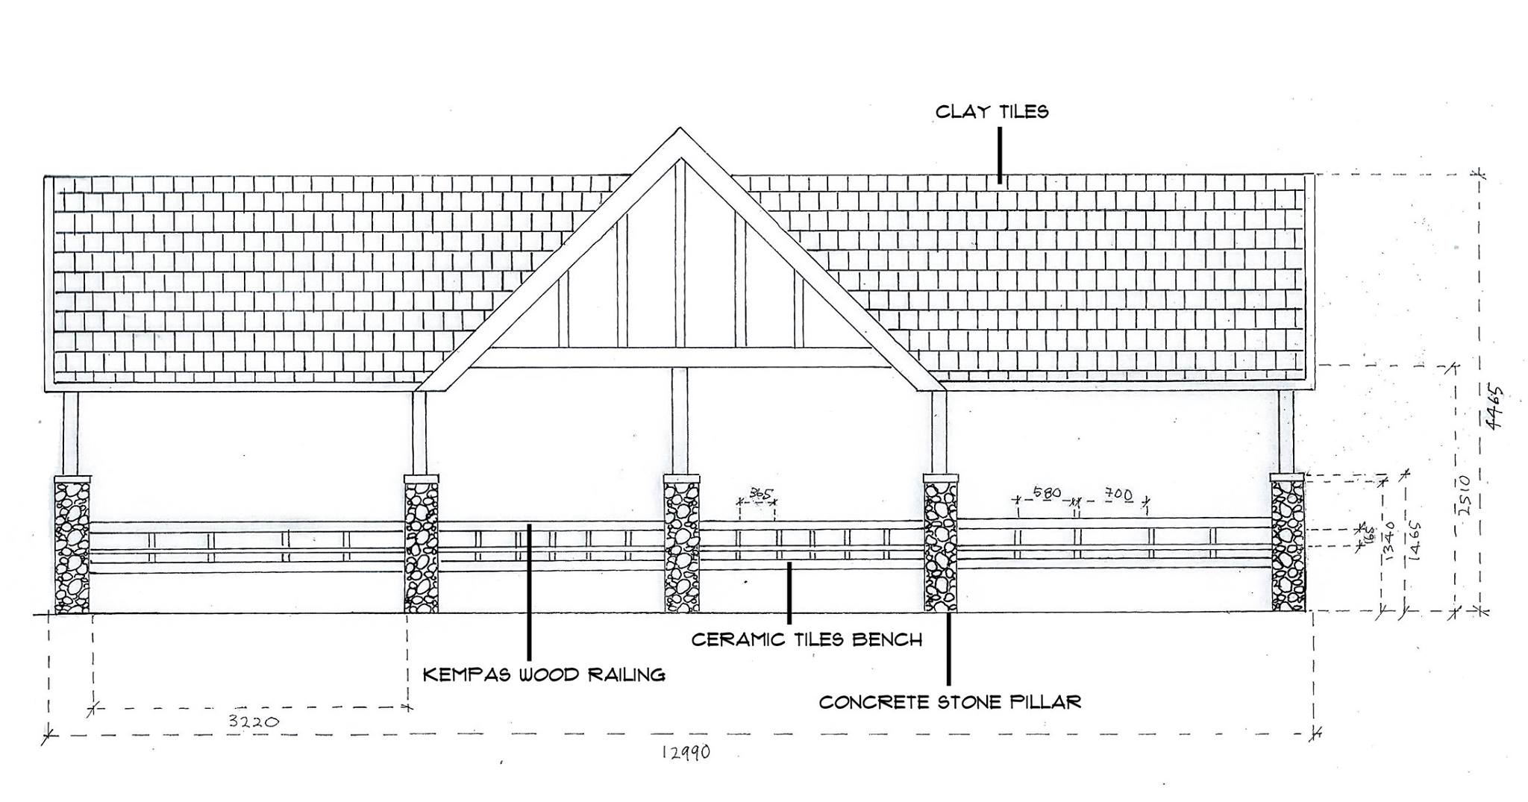
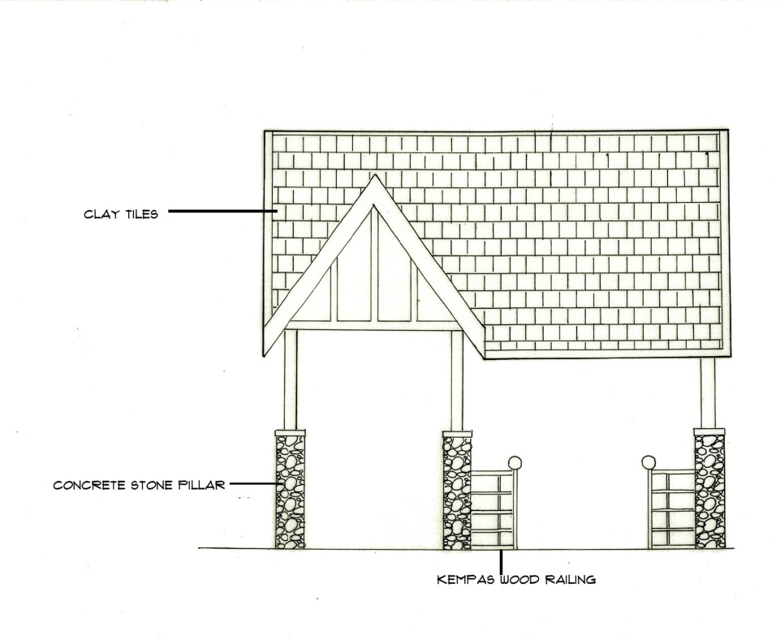
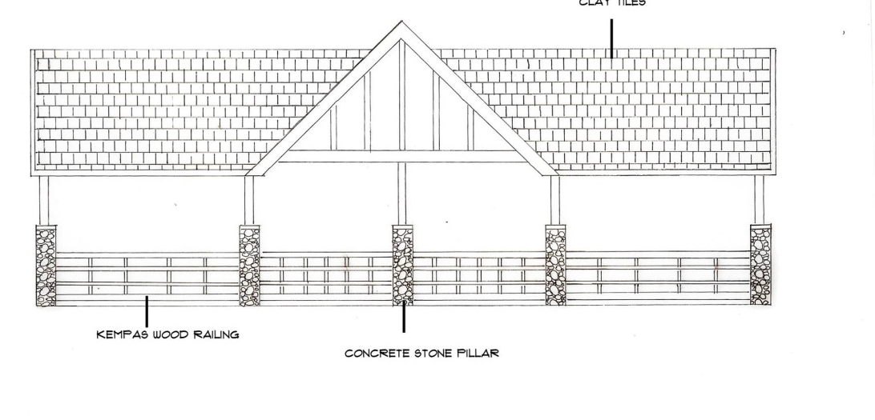
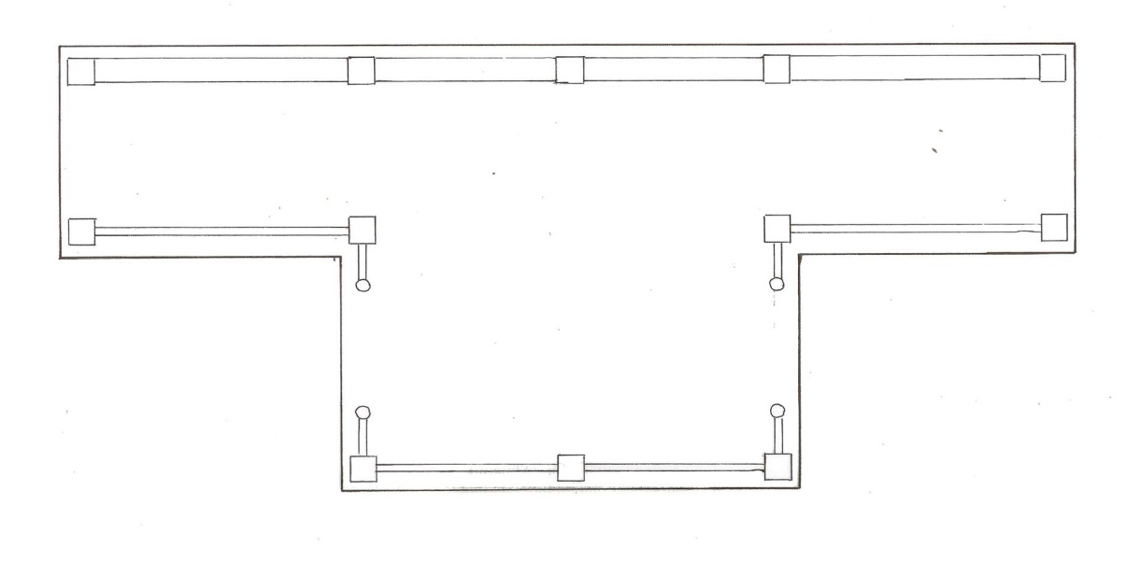
Location of the materials on structure
Water Ball Area
Back elevation
Right-Side elevation
Front elevation
Plan

Slide 14
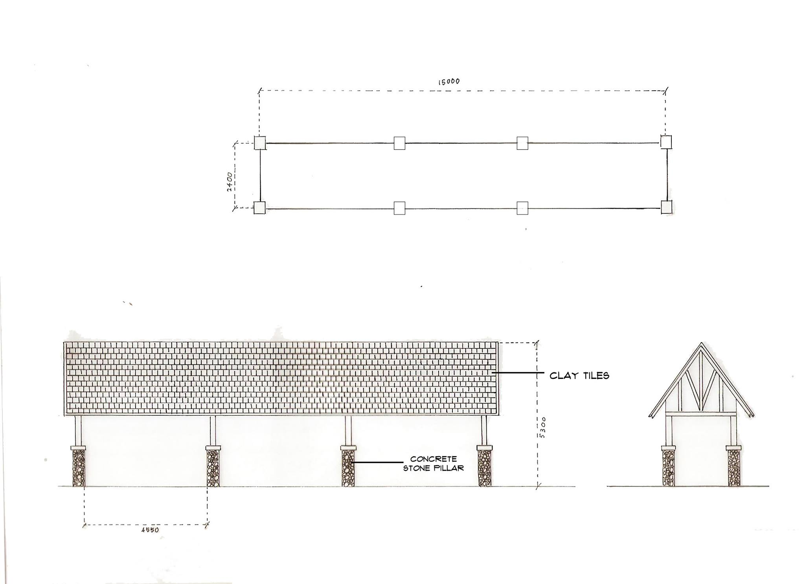
Location of the materials on structure
Water Pedal Area
Plan
Front elevation
Left elevation

Slide 15
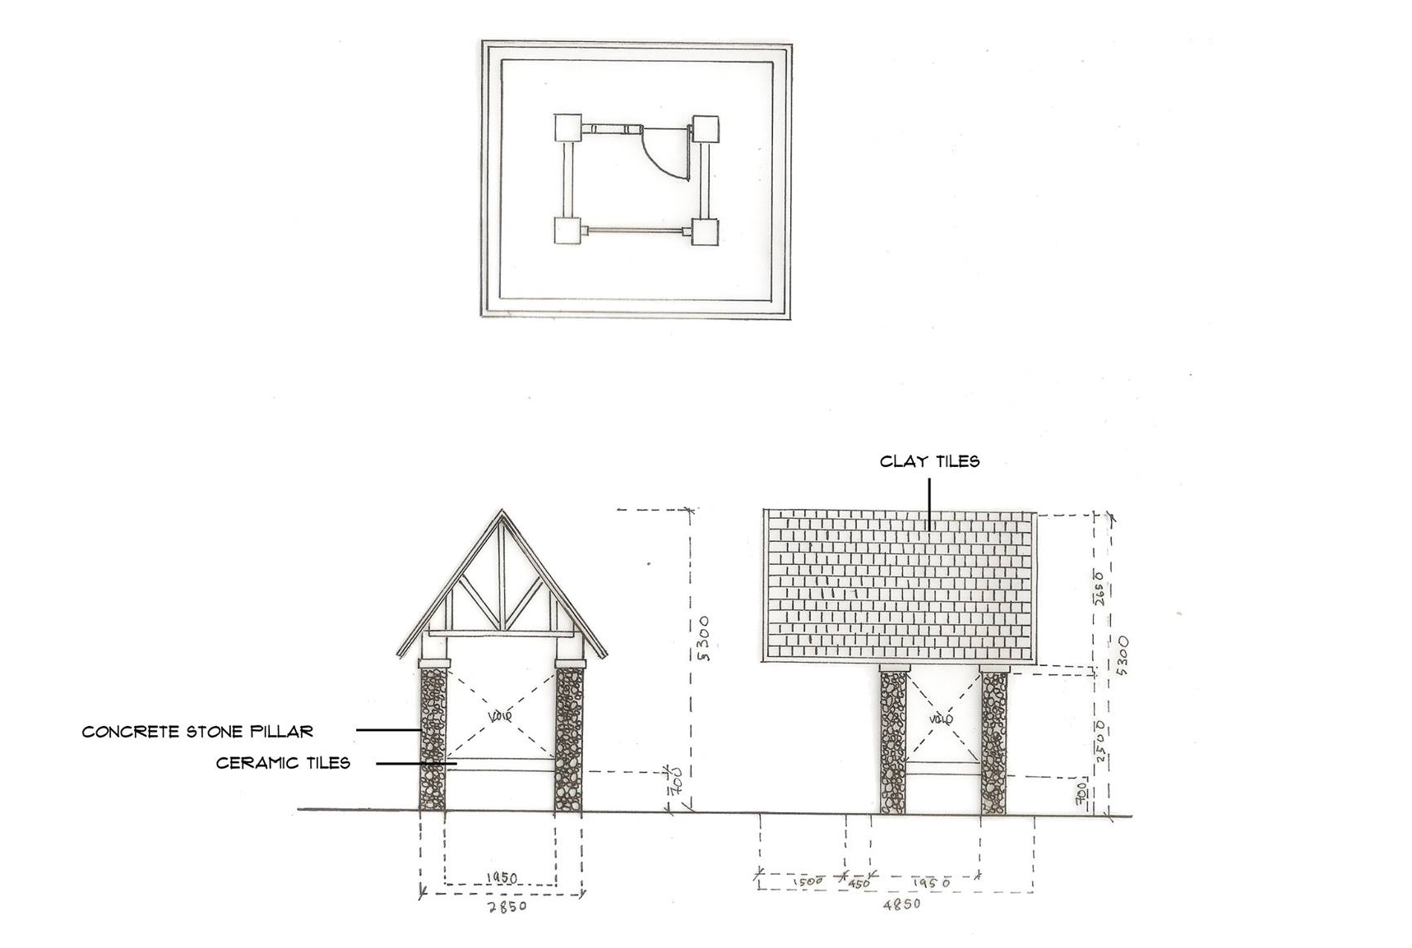
Location of the materials on structure
Snack Counter
Plan
Front elevation
Right elevation

Slide 16
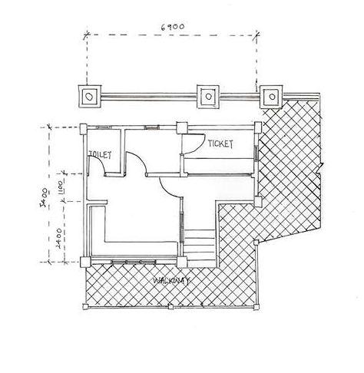
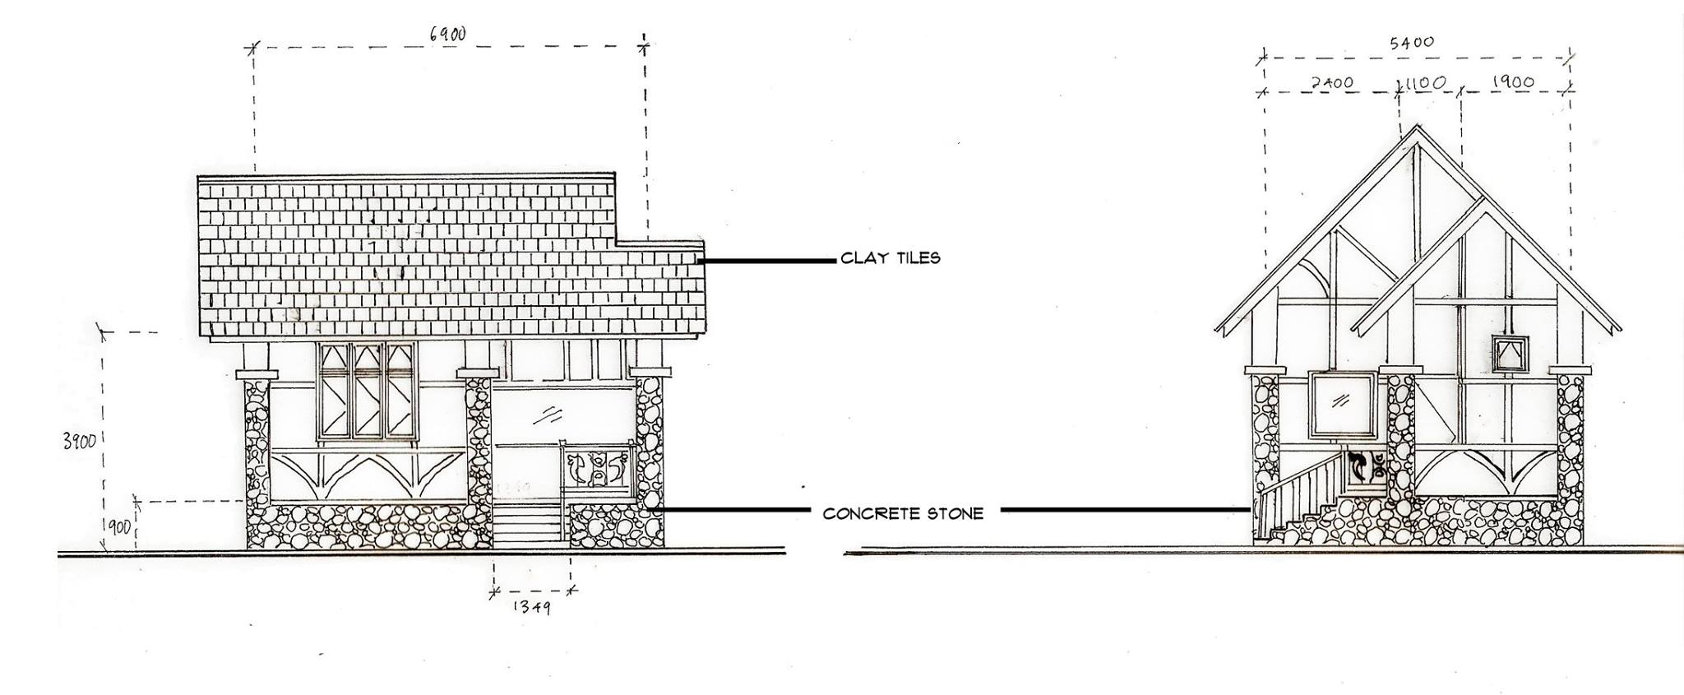
Location of the materials on structure
Plan
Front elevation
Right-Side elevation

Slide 17
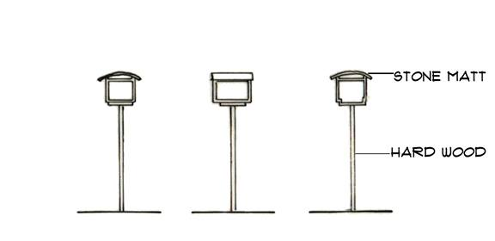
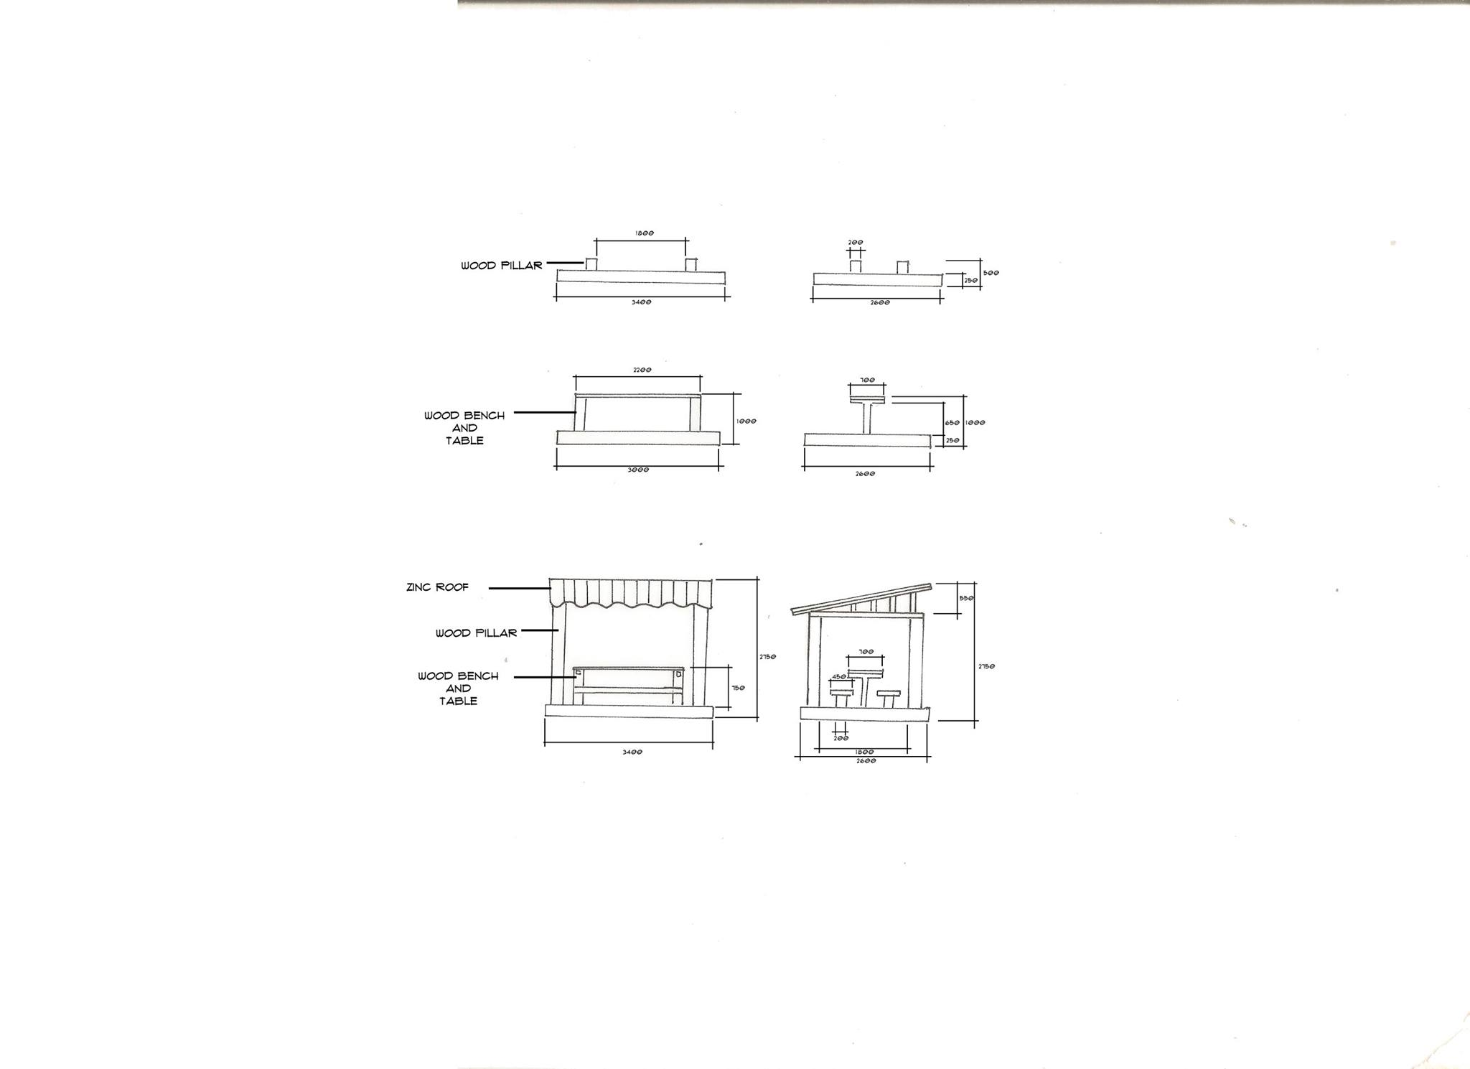
Location of the materials on structure
Bird Feeding Structure
Front elevation
Side elevation
Section
Abandoned pavilions

Slide 18
Location of the materials on structure
Abandoned pavilions
Front elevation
Right elevation
Front elevation
Right elevation
Front elevation
Right elevation

Slide 19
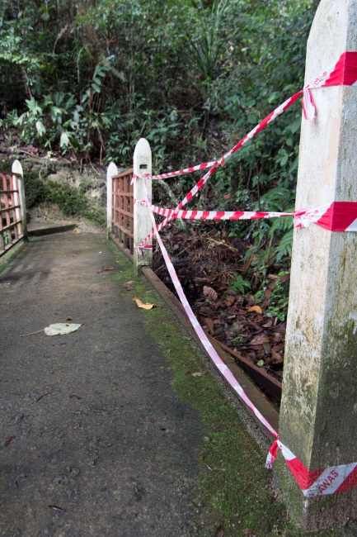
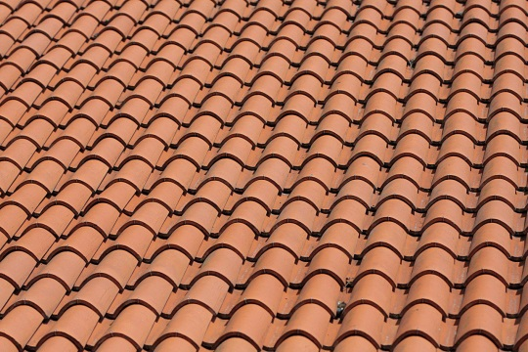
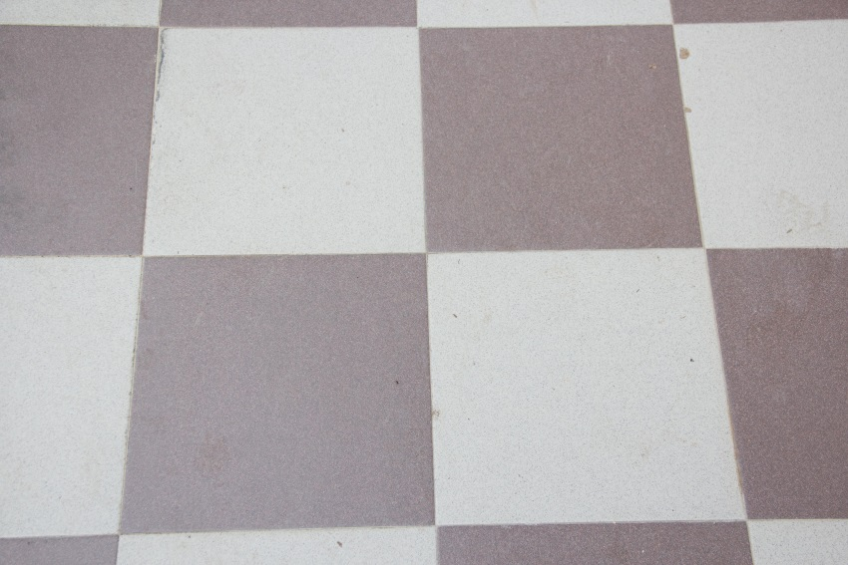

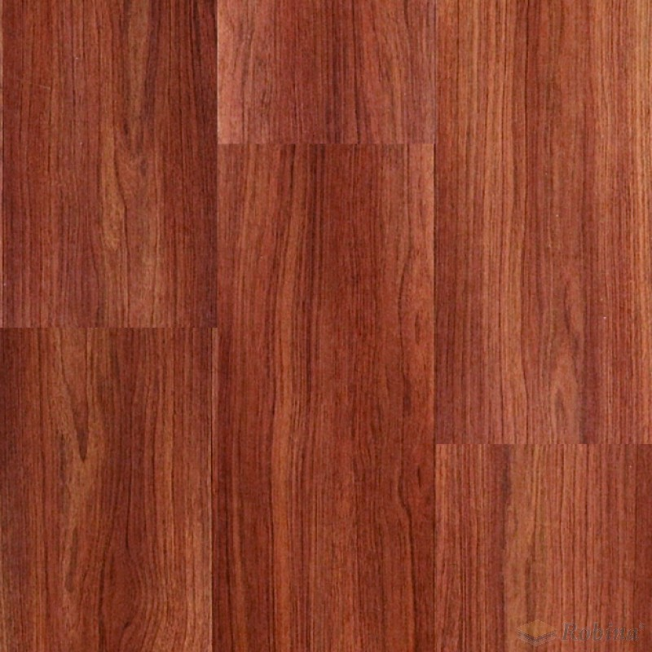
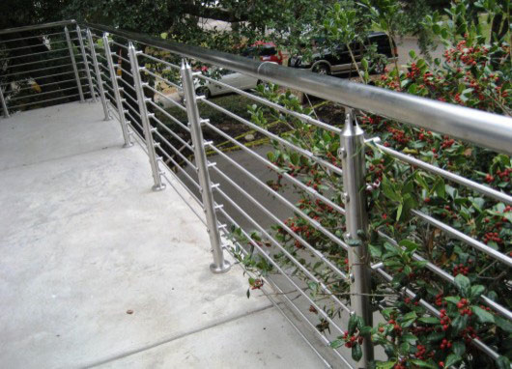
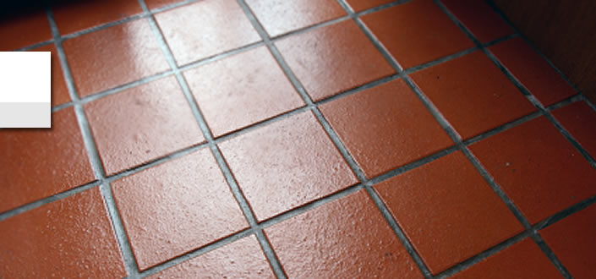
In conclusion

